Slide 1
Unit VI:
Efficient Testing and Debugging
Programming Methodology (CSF101)

Slide 2
Outline
Exceptions and Exception handling
Language Standard Library
Assertion

Slide 3
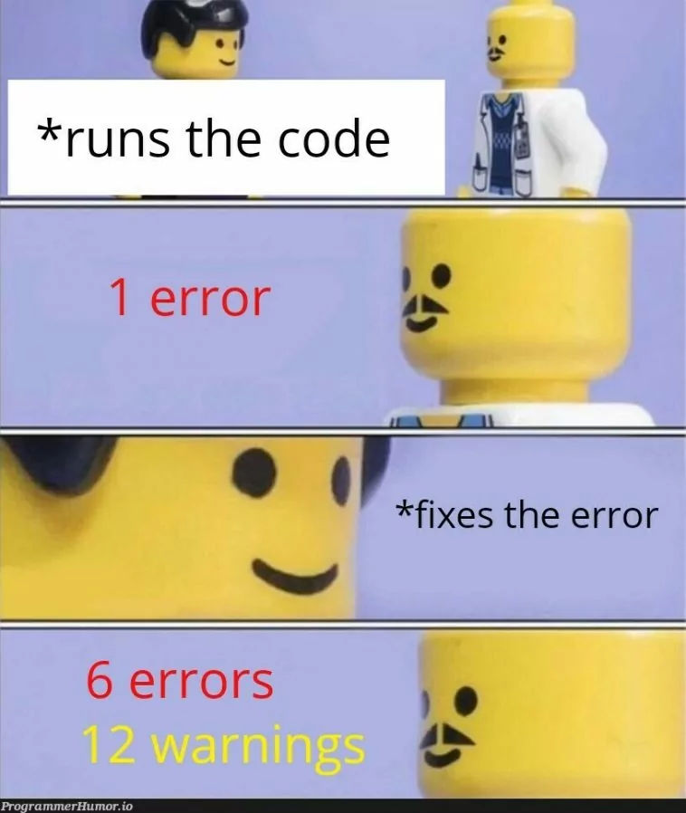

Slide 4
Debugging
Identification of Error
Fixing the bug
Analyzing

Slide 5
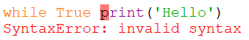
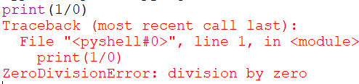
Syntax Errors and Exceptions

Slide 6
Some common built-in exceptions
TypeError
NameError
SyntaxError
indexError
ImportError
ZeroDIvisionError

Slide 7
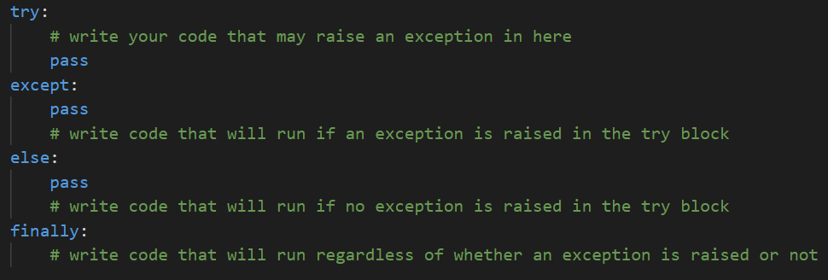
Exception Handling

Slide 8
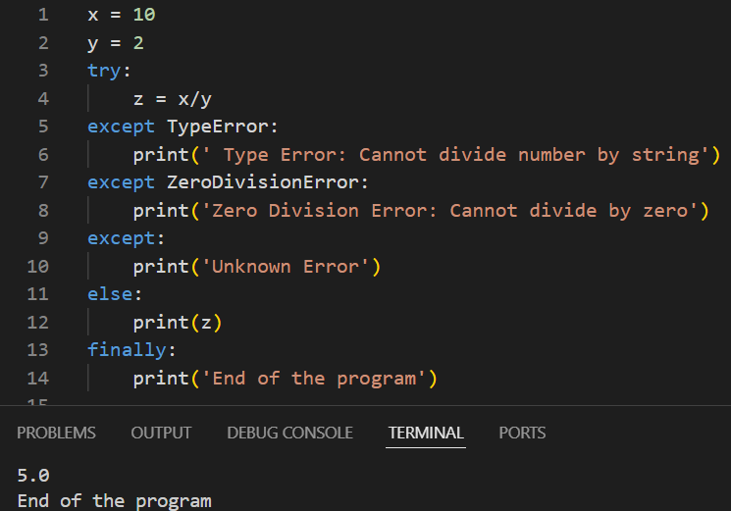
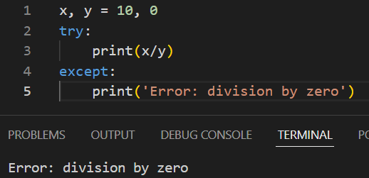
Examples

Slide 9
Testing

Slide 10
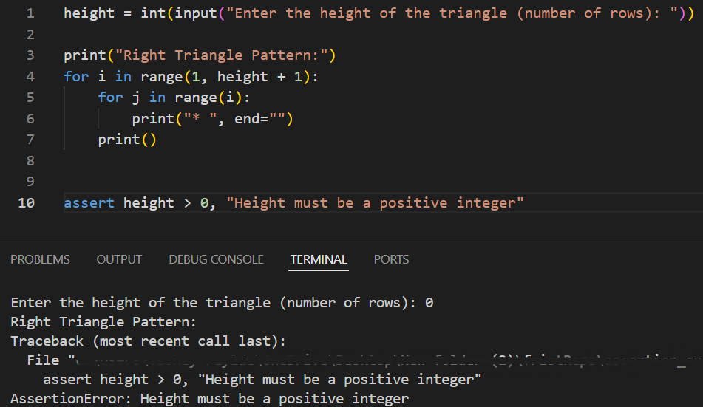
Assertion
“assert” keyword
Condition
comma
Statement for assertError

Slide 11
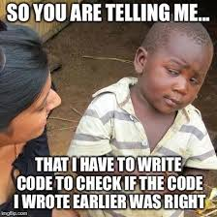

Slide 12
Test Runner - Unittest (built-in)
Steps to write test case:
Import unittest
Create a class that inherits from the TestCase class
Add methods inside the class by adding self as the first argument
Use the self.assertEqual() method on the TestCase class
Execute the test case using unittest.main()

Slide 13
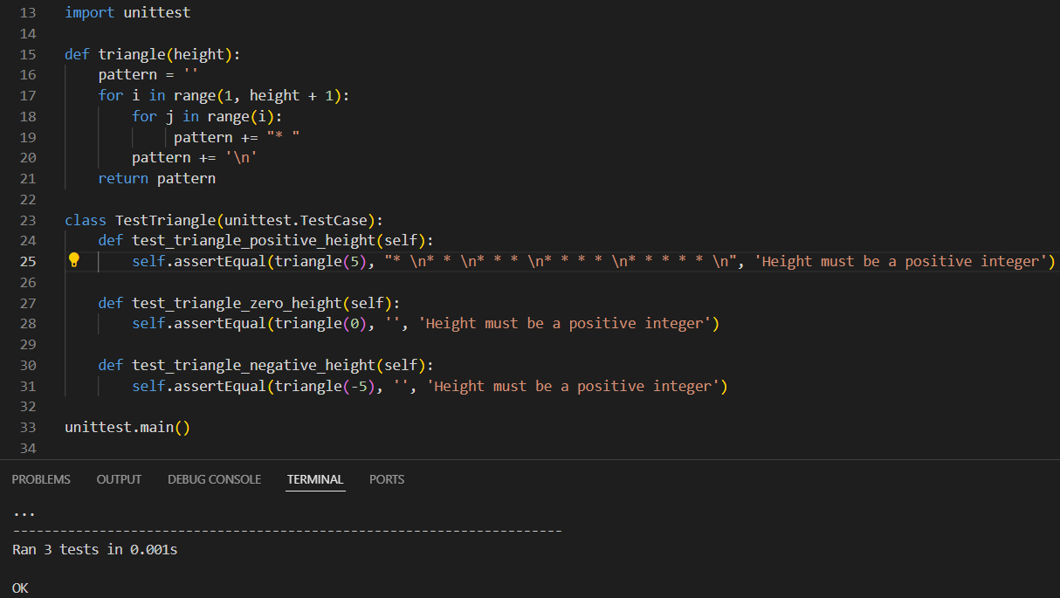
Example

Slide 14
Cont…
Output:

Slide 15
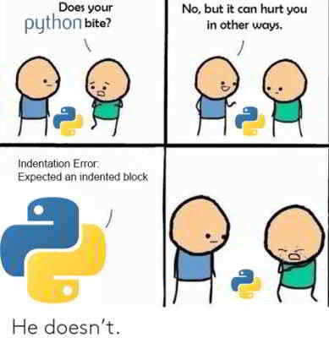

Slide 16
Reference
Automate the boring stuff with python (no date) Automate the Boring Stuff with Python book cover thumbnail. Retrieved from: https://automatetheboringstuff.com/2e/chapter11/.
8. errors and exceptions (no date) Python documentation. Retrieved from: https://docs.python.org/3/tutorial/errors.html.
GeeksforGeeks (2023) Python exception handling, GeeksforGeeks. Retrieved from: https://www.geeksforgeeks.org/python-exception-handling/.
Admin (2023) Differences between testing and debugging, BYJUS. Retrieved from: https://byjus.com/gate/difference-between-testing-and-debugging/#:~:text=Testing%20is%20the%20process%20using,differences%20between%20testing%20and%20debugging.

